Slide 1
Glyphosate
Mary Whalen and Vincent Cascio
Toxicology
5/18/15

Slide 2
Research Question:
Are there detectable levels of glyphosate residue found in food and at what level is glyphosate residue toxic to humans?

Slide 3
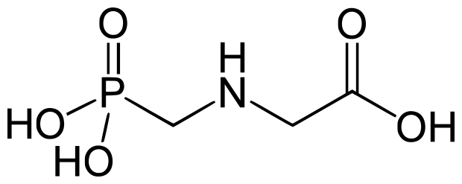
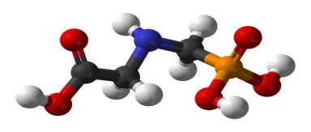
Glyphosate N-(phosphonomethyl)glycine
Glyphosate is a broad-spectrum systemic herbicide used to kill weeds, especially annual broadleaf weeds and grasses known to compete with commercial crops grown around the globe.
This compound may mimic estrogen in the body.

Slide 4
Where is it used?
Agriculture and forestry
Lawns and gardens
Industrial areas
Current glyphosate-resistant (GMO) crops include soy, maize (corn), canola, alfalfa, and cotton

Slide 5
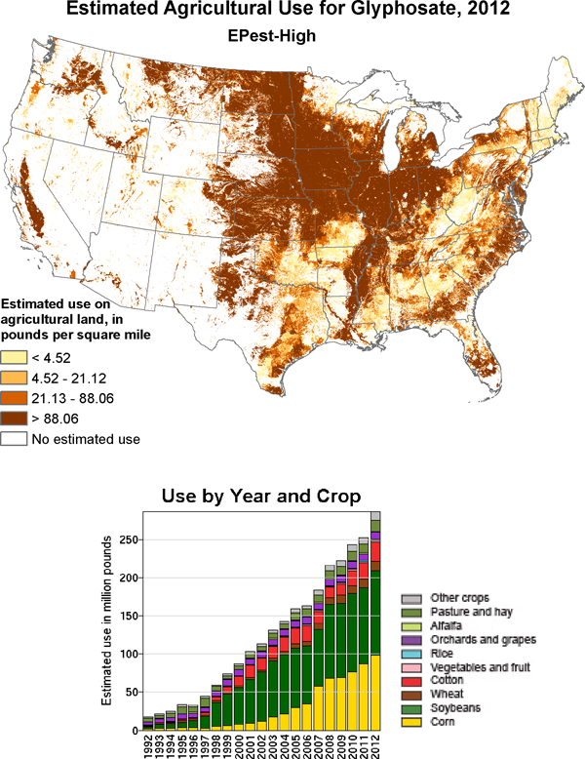

Slide 6
Exposure:
Workplace exposure
Exposure caused by off target movement following application (drift)
Contact with contaminated soil
Drinking or bathing in contaminated water

Slide 7
General Public Exposure
Human exposure to glyphosate most often occurs from the very minute amounts that remain on food that is consumed.
Allowable Daily Intake (ADI) of 1750 micrograms (ug) of glyphosate for every kilogram (kg) of body weight.
Tests for glyphosate in samples of urine suggest the typical dietary intake is well below 1% of the ADI or less than 17.5 ug per kg of body weight.

Slide 8
Toxicity
Low toxicity in mammals
Acute toxicity is dose dependent
Deliberate ingestion of Roundup in quantities ranging from 85 to 200 ml (of 41% solution) has resulted in death within hours of ingestion
Ingestion of more than 85 ml of the concentrated formulation (Roundup) is likely to cause significant toxicity in adults

Slide 9
Metabolism
Glyphosate undergoes little metabolism and is excreted mostly unchanged in the feces and urine.
Two human patients who were poisoned with glyphosate had peak plasma glyphosate concentrations within 4 hours of ingestion.
After 12 hours, glyphosate was almost undetectable.

Slide 10
Risk of Exposure
The oral absorption of glyphosate is low, and eliminated essentially un-metabolized.
Dermal penetration studies with Roundup showed very low absorption.
Experimental evidence has shown that glyphosate does not bioaccumulate in any animal tissue.
No significant toxicity occurred in acute, subchronic, and chronic studies.
Direct ocular exposure to the concentrated Roundup formulation can result in transient irritation

Slide 11
Alternatives:
Organic farming
Integrated weed management
Vinegar based herbicides

Slide 12
References:
http://www.ncbi.nlm.nih.gov/pubmed/237561702
http://npic.orst.edu/factsheets/glyphogen.html
http://npic.orst.edu/factsheets/glyphotech.pdf
http://en.wikipedia.org/wiki/Glyphosate
http://www.agbioforum.org/v12n34/v12n34a10-duke.htm
http://www.fs.fed.us/r5/hfqlg/publications/herbicide_info/2003_glyphosate.pdf
http://www.ncbi.nlm.nih.gov/pmc/articles/PMC1241861/
http://www.ipm.ucdavis.edu/PMG/r603700111.html
http://www.ces.ncsu.edu/fletcher/programs/xmas/pesticides/labels/Roundup-orig-max-msds.pdf
http://extension.umd.edu/sites/default/files/_docs/programs/ipmnet/Vinegar-AnAlternativeToGlyphosate-UMD-Smith-Fiola-and-Gill.pdf

